Slide 1
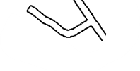
Route 26 Thursday
HYLANDS CLOSE
WO
DEPOT ROAD
DULSHOTT GREEN
DOWNS WAY
26TH

