Slide 1
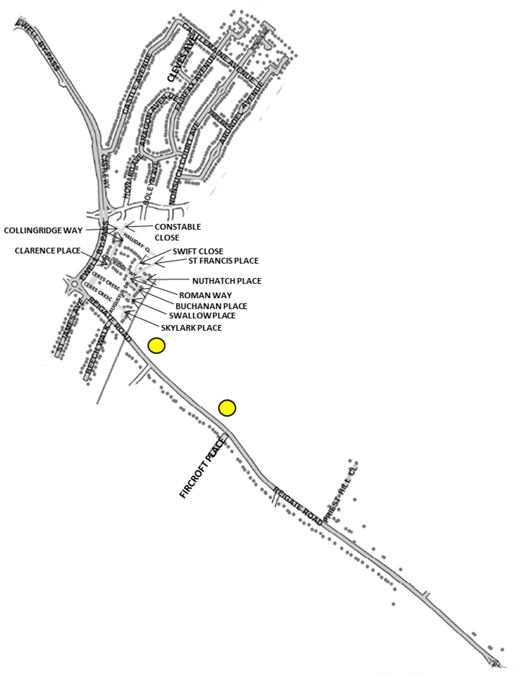
Route 27 Thursday
GREEN LANES (EVENS)
27TH

